Slide 1
THE INFLUENCE OF INDIVIDUAL CHARACTERISTICS AND ENVIRONMENTAL FACTORS ON THE SUCCESS OF YOUNG ENTREPRENEURS
INTO-Mason Multidisciplinary Colloquium
Johnson Center, Room A
April 29th 2015
Trung Hoang Master of Business Administration
Notes:
Good morning everyone, thank you for being here today
My name is Trung, I come from Vietnam, I hold a bachelor degree in Automation and now study in MBA program of GMU
today I would like to present to you my topic of “Influence of…”

Slide 2
Index
Purpose of Study
Bilingual Abstract
Research Question
Finding from Literature Review
Suggestion for Future Research
Conclusion
Notes:
My presentation will follow the index, which has purpose of study,….

Slide 3
Purpose of Study
The number of established firms stays the same.
The number of bankruptcy cases increases more than 15% from 2011 to 2013.
A need to study entrepreneurship in order to provide support mechanisms to reduce the number of bankruptcy cases.
(Bankruptcyaction, 2014)

Slide 4
Index
Purpose of Study
Bilingual Abstract
Research Question
Finding from Literature Review
Suggestion for Future Research
Conclusion

Slide 5
Bilingual Abstract
English
Because of the increasing number of bankruptcy filings in Vietnam, this presentation will examine how entrepreneurs’ individual characteristics and environmental factors influence their firm’s success in order to make recommendations and build support mechanisms for young entrepreneurs in East Asian countries, particularly Vietnam. In this presentation, the most important factors are identified and categorized into two main groups, which are environmental factors, such as age, education or experience of the owners, and individual characteristics like motivation and leadership style.
Vietnamese
Sự gia tăng đột biến của số lượng các công ty phá sản ở Việt Nam trong thời gian qua dẫn tới việc nghiên cứu các yếu tố tác động tác động đến sự thành công của doanh nghiệp. Qua đó, chúng ta có thể xây dựng các chương trình đào tạo và hỗ trợ các doanh nghiệp trẻ ở các nước Đông Nam Á, đặc biệt là Việt Nam. Các yếu tố của chủ doanh nghiệp tác động đến thành công được chia làm hai nhóm, các yếu tố ngoại cảnh như tuổi, giáo dục hay kinh nghiệm của chủ doanh nghiệp cũng như các yếu tố bên trong như động cơ thành lập doanh nghiệp hay phong cách lãnh đạo.

Slide 6
Bilingual Abstract
English
Because of the increasing number of bankruptcy filings in Vietnam, this presentation will examine how entrepreneurs’ individual characteristics and environmental factors influence their firm’s success in order to make recommendations and build support mechanisms for young entrepreneurs in East Asian countries, particularly Vietnam. In this presentation, the most important factors are identified and categorized into two main groups, which are environmental factors, such as age, education or experience of the owners, and individual characteristics like motivation and leadership style.
German
Aufgrund der zunehmenden Anzahl der Bankrotter in Vietnam, wird diese Präsentation den Einfluss der Unternehmers inneren Eigenschaften und äußeren Faktoren zu den Erfolg ihres Unternehmens zu untersuchen, um die Empfehlungen und Unterstützungsmechanismen für junge Unternehmer in ostasiatischen Ländern, insbesondere in Vietnam, zu geben. In dieser Präsentation, werden die wichtigsten Faktoren identifizieren und in zwei Hauptgruppen sortieren, welche die äußere Faktoren, wie die Alter, Ausbildung oder Erfahrung der Besitzer, und inneren Eigenschaften wie Motivation oder die Führung von der Unternehmen.

Slide 7
Index
Purpose of Study
Bilingual Abstract
Research Question
Finding from Literature Review
Suggestion for Future Research
Conclusion

Slide 8
Research Question
Which characteristic factors influence the success of young entrepreneurs and how might we apply the existing research to build appropriate support mechanisms for young entrepreneurs in Vietnam?
Notes:
With the curious from why some entrepreneurs are very successful, when the other not.
Lead me to my research question

Slide 9
Index
Purpose of Study
Bilingual Abstract
Research Question
Finding from Literature Review
Suggestion for Future Research
Conclusion

Slide 10
Findings from Literature Review
Environmental Factors
Individual Characteristics
Age of owners
Education and experience
Push versus pull motivations
Type of leadership:
Charismatic versus pragmatic entrepreneurs
Notes:
After examine 10 Literature, I found that the most important factors devided In two major group:
Here I would like to explain that environmental factors are mainly outside factors that influence the entrepreneur, normally they cannot control it in a short time.
Individual is more like innere personalities.

Slide 11
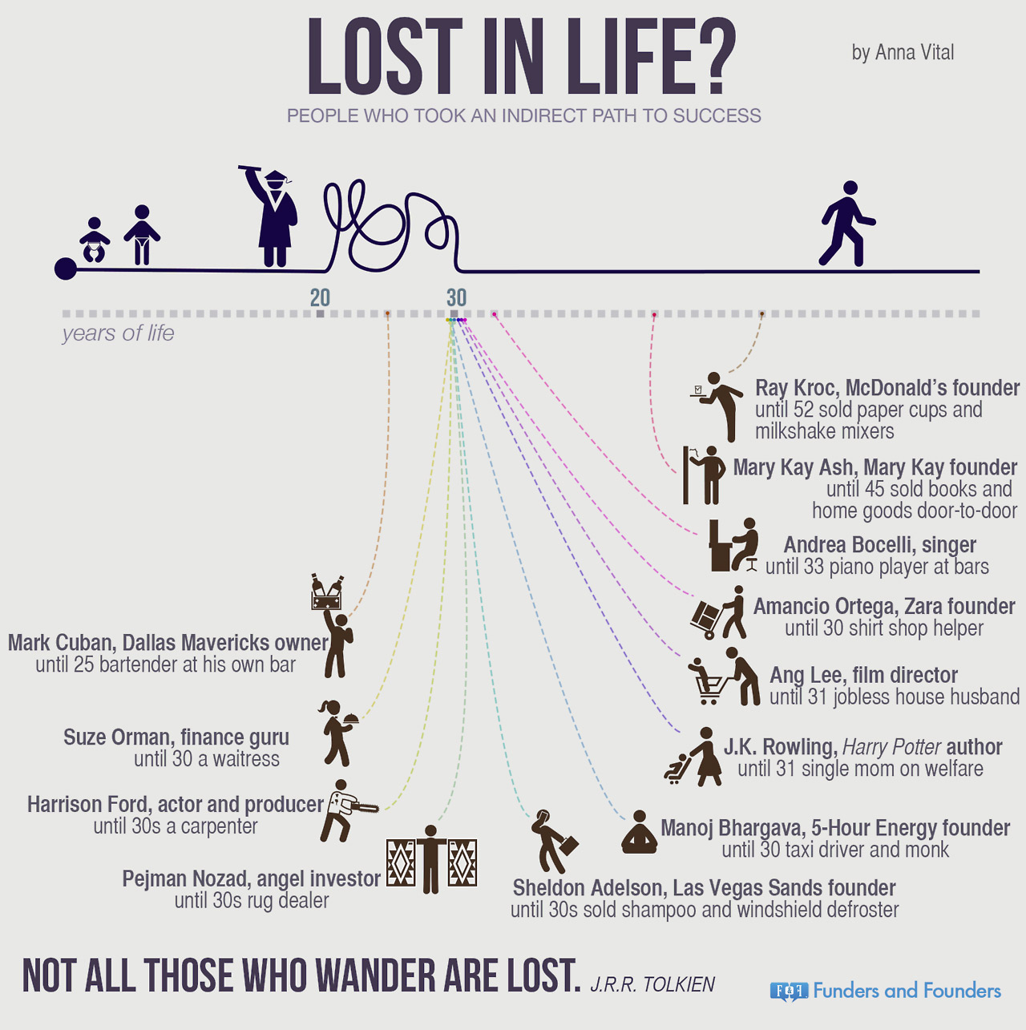
Environmental factors: Age of owners
Ray Kroc established Mc Donald at age 52
Colonel Harland David Sanders opened KFC at age 40
J.K. Rowling is a jobless single mom at age 31
(Fundersandfounders, 2015)

Slide 12
Environmental factors: Age of owners
Too young?
Lack of essential managerial experience
(Miettinen & Littunen,2012)
Too old?
Difficulty adapting to the changing business environment
Health problems
(Miettinen & Littunen,2012)
Middle-aged firm owners from 30-49 years old tend to be most successful at maintaining and growing their start-ups
(Miettinen & Littunen,2012)
(Honj, 2004)

Slide 13
Environmental Factors: Education and Experience
Education
Experience
Education of owners plays an important role in business growth and survival
(Miettinen & Littunen, 2012)(Honj, 2004)
Entrepreneurs with master's degrees outperformed those with Ph.D degrees (Sapienza et al.,1998)
In Vietnam and China, only 20% of entrepreneurs from successful companies completed colleges or graduate schools
(Perri and Chu, 2012)
Specific human capital: education and professional experience in the field in which the entrepreneurs open their firms
Generic experience: working experience gained by founders in other sectors
In order to run businesses effectively, specific human capital is far more important than generic experience
(Colombo et al. 2004)

Slide 14
Individual Characteristics: Push versus Pull Motivations
Push Motivations
Pull Motivations
Escaping from unemployment
Providing jobs for family members
Job security
Being closer to family
(Miettinen & Littunen, 2012)
(Perri and Chu, 2012)
Being own boss
Desiring achievement
Needing autonomy
Gaining public recognition
Increasing annual income
(Mocnik, 2010)
(Perri and Chu, 2012)
Less likely to be successful
More likely to be successful
Notes:
Think about when you are at the swimming pool, the different between you actively jump and other people push you make a huge different.

Slide 15
Type of leadership Charismatic and Pragmatic Entrepreneurs
Charismatic entrepreneurs
Pragmatic entrepreneurs
Visionaries
Risk-takers
Highly persuasive
Passionate and ambitious
Idealistic
Cautious
Rational
Analytical
Systematic
A business run by charismatic entrepreneurs grow more rapidly but are less sustainable than businesses run by pragmatic owners
(Mccarthy, 2003)
Notes:
A typical charismatic entrepreneurs is Steve Job, he always create new products and lead the market.
A more traditional firm owner leadership is pragmatic. The owner often believe in statistical and analytical number.
However,….

Slide 16
Index
Purpose of Study
Bilingual Abstract
Research Question
Finding from Literature Review
Suggestion for Future Research
Conclusion

Slide 17
Suggestions for Future Research
Study about why only a low number of successful entrepreneurs in Vietnam and China go to universities, compared to the U.S
Man versus Woman Entrepreneurs: Motivations and Success
With a low number of educated entrepreneurs, the average age of firm owners might also be shifted.
For Asian, collectivism culture, communist party, which type of leadership should firm owners possess, and which one will be more likely to be successful
Notes:
Vietnam is a developing country with a GDP from just $2,000 USD. All the content and conditions will be much different than the U.S.

Slide 18
Index
Purpose of Study
Bilingual Abstract
Research Question
Finding from Literature Review
Suggestion for Future Research
Conclusion

Slide 19
Conclusion
Environmental factors
Individual Characteristics
Age of owners
Education and Experience
Push versus pull motivations
Charismatic versus pragmatic entrepreneurs

Slide 20
References
Bankruptcyaction. (2014). Retrieved from http://media.doisongphapluat.com/307/2014/1/9/kinhdoanh-kinh-te-2014-thuan-loi1.jpg
Colombo, M., Delmastro, M., & Grilli, L. (2004). Entrepreneurs' human capital and the start-up size of new technology-based firms. International Journal of Industrial Organization, 1183-1211.
Fundersandfounders. (2015). Retrieved from
http://fundersandfounders.com/lost-in-life-people-indirect-path-to-success/
Honj, Y. (2004). Growth of new start-up ﬁrms: evidence from the Japanese manufacturing industry. Applied Economics Letters, 21-32.
Mccarthy, B. (2003). The impact of the entrepreneur's personality on the strategy-formation and planning process in SMEs. The Irish journal of management, 154-172.
Miettinen, M. R., & Littunen, H. (2012). Factors contributing to the success of start-up firms using two-point or multiple-point scale models. Competitive Research Article, 449-481.
Perri, D. F., & Chu, H. M. (2012). Entrepreneurs in China and Vietnam: Motivations and problems. International Journal of Entrepreneurship, 93-112.
Sapienza, H. J., & Grimm, C. M. (1998). Founder characteristics, start-up process, and strategy/structure variables as predictors of shortline railroad performance. Entrepreneurship Theory and Practise, 5-24.

